Slide 1
Neural Network Based
Speech to Speech
Translation
Temporally, all the papers claimed to achieve speech-to-speech translation are based on “Voice recognition + Translate + TTS”
We found that maybe it can be done in two steps: “Voice to foreign Text + TTS”based on NN.

Slide 2
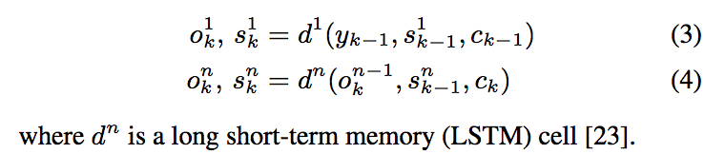
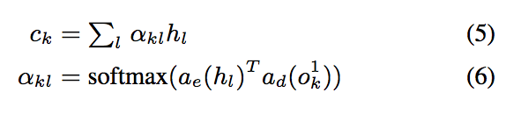
Sequence-to-Sequence Models
Seq2seq(or RNN Encoder–Decoder) model (Cho et al., 2014) based. Basic seq2seq consists of two recurrent neural networks (RNNs): an encoder that processes the input and a decoder that generates the output.
In this article, 3 NN are used: Encoder -> Decoder, Attention Network.
Encoder: Recurrent NN. Turn input feature frames x_{1..T} to a sequence of hidden activation, h_{1..L} .
Decoder: A stacked RNN with D layers, input: h and y_{k-1} , output: y_{k}. Dependence on the input c_{k,} which is mediated through an attention network,a fixed dimensional context vector.
Attention Network: summarizes the entire input sequence as c_{k} c_{k} , computed from the first decoder layer output at each output step k. a_{e} and a_{d} are small fully connected networks.

Slide 3
Sequence-to-Sequence Models
For both end-to-end speech translation, and speech recognition baseline model to compare.
Use 80 channel log mel filterbank features extracted from 25ms windows with a hop size of 10ms, stacked with delta and delta-delta features. The output softmax of all models predicts one of 90 symbols, that includes English and Spanish lowercase letters.
Encoder(8 layers): Raw feature, delta, delta-deltas formed as a T × 80 × 3 tensor -> two conv layers with ReLU and Batch normalization -> bidirectional convolutional LSTM(1×3 filter) -> three bidirectional LSTM layers of size 256 in each direction, interleaved with a 512-dimensional linear projection, followed by batch normalization and a ReLU activation -> get 512-dimensional encoder representation, h_{l}.
Attention Network: a_{e} and a_{d} , each contain a single hidden layer with 128 units -> c_{k}
Decoder: Input is created by concatenating a 64- dimensional embedding for y_{k−1}, the symbol emitted at the previous time step, and c_{k} . Input -> a stack of four unidirectional LSTM layers with 256 units. The concatenation of the attention context and LSTM output is passed into a softmax layer which predicts the probability of emitting each symbol in the output vocabulary

Slide 4
Sequence-to-Sequence Models
Neural Machine Translation Model
  Text to text, as baseline, to compare with end-to-end model.
  Encoder: The encoder network consists of four encoder layers (5 LSTM layers in total). As in the base architecture, the bottom layer is a bidirectional LSTM and the remaining layers are all unidirectional.
  Decoder: The decoder network consists of 4 stacked LSTM layers. All encoder and decoder LSTM layers contain 512 units.
  Attention Network: The attention network uses a single hidden layer with 512 units. Use the same character-level vocabulary for input and output as the speech model.
Multitask Training
  Using supervision from source language transcripts by jointly training speech recognition and translation models in a multi-task configuration.
  Using 16 asynchronous workers, weight noise is introduced after 30k overall steps, and the learning rate is decayed after 1.5m overall steps.

Slide 5
Sequence-to-Sequence Models
Implementation: TensorFlow
  Speech Model
    Adam optimizer, β1 = 0.9, β2 = 0.999, and ε = 10⁻⁶
    Learning rate: start from 10⁻³, decayed by a factor of 10 after 1m steps
    L2 weight decay is used with a weight of 1e-6, and, beginning from step 20k.
    Gaussian weight noise with std of 0.125 is added to weights for all LSTM layers and decoder embeddings.
    Optimized and tuned for Fisher dataset.
  NMT Model
    To reduce overfitting on the small training corpus, used reduced sized model.
    Applied dropout with probability 0.2 during training to reduce overfitting.
    Train using SGD with a single replica. Training converges after about 100k steps using mini-batches of 128 sentence pairs.

Slide 6
Sequence-to-Sequence Models
Experiments:
  On Spanish-English, Spanish from Fisher and Callhome dataset. English from translation of Spanish dataset.
  Tuning depth of decoder: automatic speech recognition (ASR) normally uses shallow decoder, NMT models often use much deeper decoders
  Tuning multitask training:
    One-to-many in which an encoder is shared between speech translation and recognition tasks (Perform Better)
    Many-to-one in which a decoder is shared between speech and text translation tasks
  Report speech recognition results as word error rates (WER) and translation results using BLEU (bilingual evaluation understudy)

Slide 7
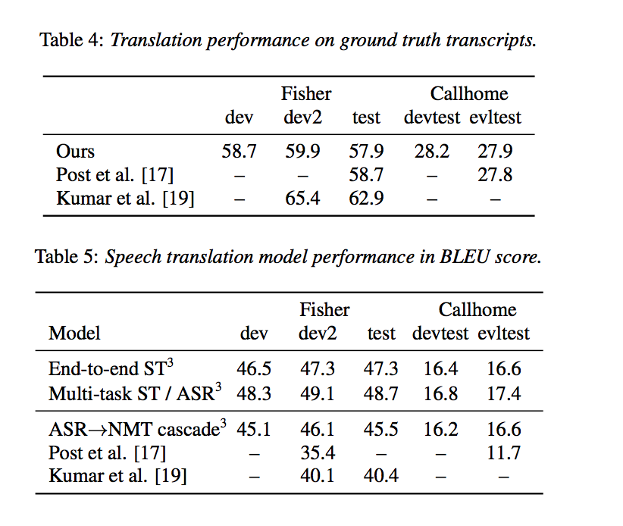
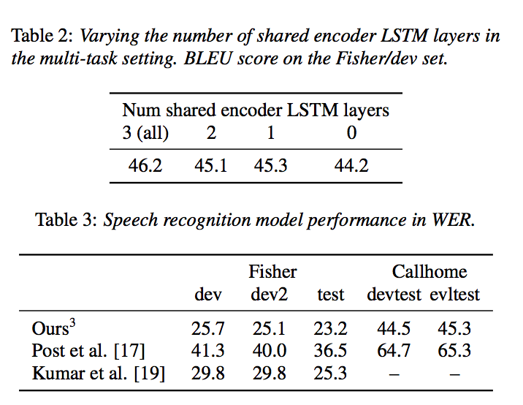
Sequence-to-Sequence Models
Experiments results:

Slide 8
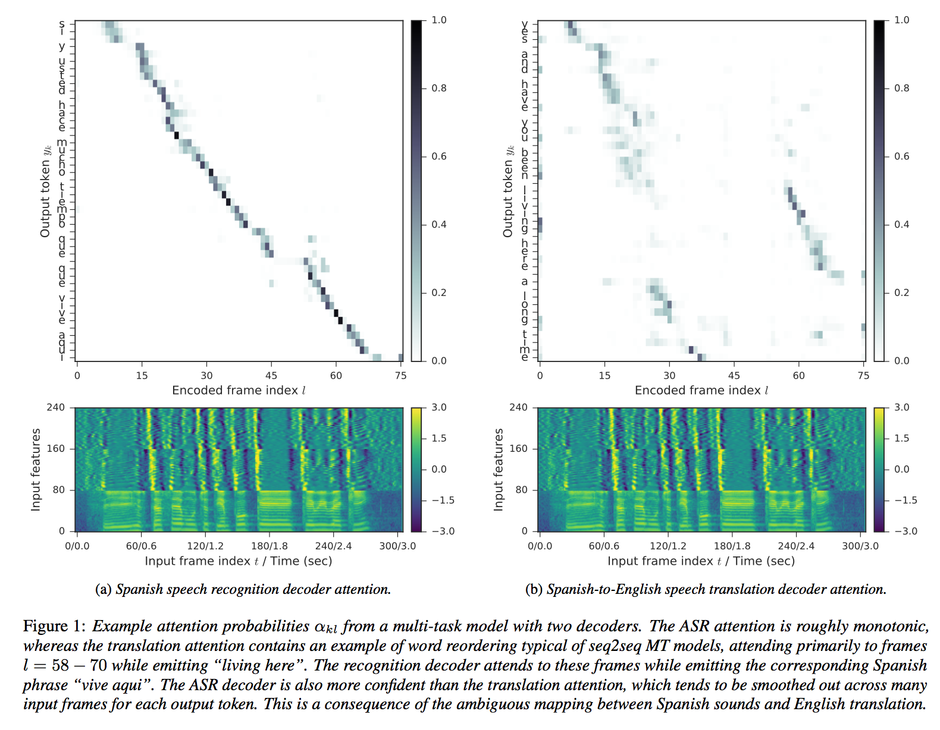
Sequence-to-Sequence Models
Experiments results:
Jointly training decoder networks for
multiple languages regularizes the encoder
and improves overall speech translation
performance.

Slide 9
Deep Voice: Real-time Neural TTS
Overview:
Use Deep Neural Network throughout the whole TTS process
Fewer parameters training for better data adaptation
Production-ready quality:
Real-time responsive
Tunable trade-off between accuracy and speed
Completely standalone, can be trained from scratch using a dataset of short audio clips and corresponding textual transcripts.
Go here for experiencing the synthesized voice that sounds almost as natural as human beings

Slide 10
Models
Deep Voice: Real-time Neural TTS
Grapheme-to-phoneme conversion model
  Phonemes encoded using a phonemic alphabet such as ARPABET
Segmentation model
  Identifies where in the audio each phoneme begins and ends.
Phoneme duration prediction model
Fundamental frequency prediction model
  Predicts whether a phoneme is voiced and its fundamental frequency (F0) if it is
Audio synthesis model
  Combines the outputs of the aforementioned models at a high sampling rate

Slide 11
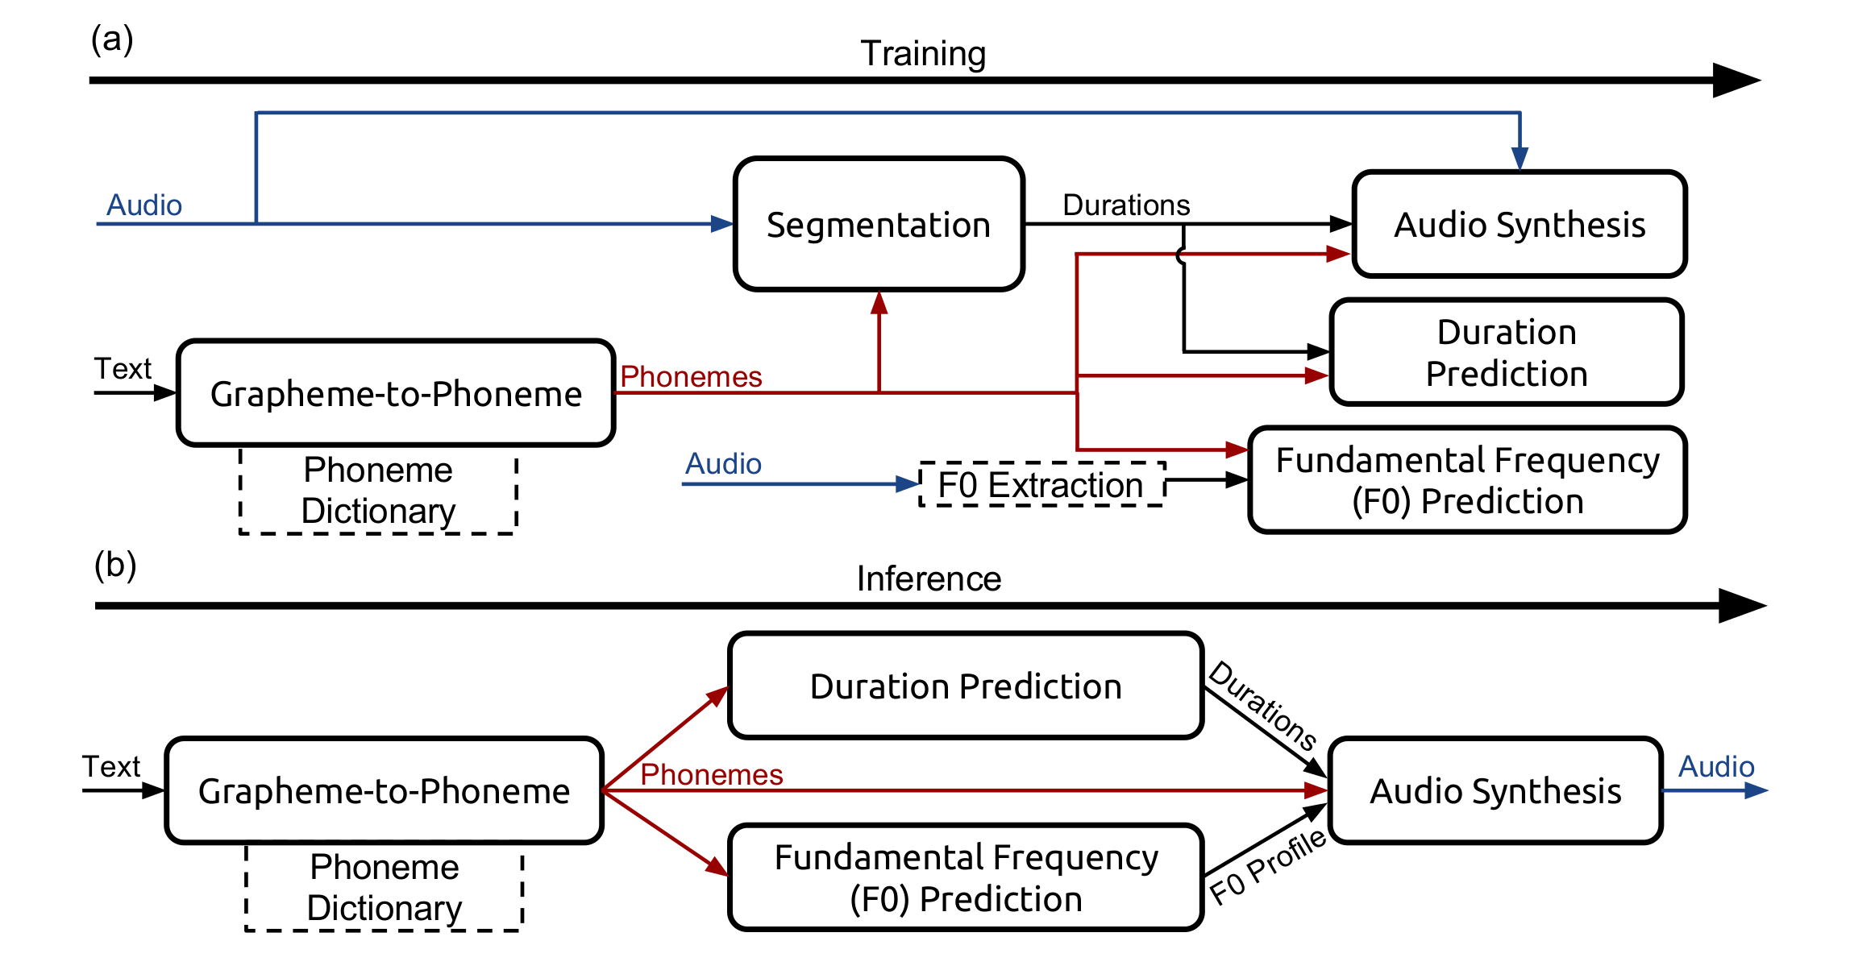
Models in a nutshell
Deep Voice: Real-time Neural TTS
Models are
implemented using the TensorFlow framework
trained on two datasets spoken by a professional female speaker
    an internal English speech containing approximately 20 hours of speech data segmented into 13,079 utterances
    a subset of the Blizzard 2013 data to demonstrate flexibility

Slide 12
Grapheme-to-Phoneme Model
Deep Voice: Real-time Neural TTS
A multi-layer bidirectional encoder with a gated recurrent unit (GRU) nonlinearity and an equally deep unidirectional GRU decoder
  The initial state of every decoder layer is initialized to the final hidden state of the corresponding encoder forward layer.
  The architecture is trained with teacher forcing and decoding is performed using beam search.
  3 bidirectional layers with 1024 units each in the encoder
  3 unidirectional layers of the same size in the decoder
  A beam search with a width of 5 candidates
  Dropout with probability 0.95 after each recurrent layer
For training, use the Adam optimization algorithm with
β₁ | β₂ | ε | batch size | learning rate | annealing rate applied every 1000 iterations
0.9 | 0.999 | 10⁻⁸ | 64 | 10⁻³ | 0.85

Slide 13
Segmentation Model
Deep Voice: Real-time Neural TTS
Annotate the training voice data with phoneme boundaries
Trained to output the alignment between a given utterance and a sequence of target phonemes
Connectionist temporal classification (CTC) loss function for a mapping between sound and text
Adapt the convolutional recurrent neural network architecture from Deep speech 2 (End-to-end speech recognition in English and Mandarin) for phoneme boundary detection
A highlight point: Train to predict sequences of phoneme pairs rather than single phonemes for precise boundary detection and brief peaks elimination
  The network will then tend to output phoneme pairs at timesteps close to the boundary between two phonemes in a pair
Adam optimization algorithm:
β₁ | β₂ | ε | batch size | learning rate | annealing rate applied every 500 iterations
0.9 | 0.999 | 10⁻⁸ | 128 | 10⁻⁴ | 0.95

Slide 14
Duration and Frequency Model
Deep Voice: Real-time Neural TTS
Jointly prediction
  Input a sequence of phonemes with stresses, with each phoneme and stress being encoded as a one-hot vector
  First two fully connected layers with 256 units each (dropout probability 0.8)
  Then two unidirectional recurrent layers with 128 GRU cells each
  Finally one fully-connected output layer (dropout probability 0.8) produces three estimations for every input phoneme
    The phoneme duration
    The probability that the phoneme is voiced (i.e. has a fundamental frequency)
    20 time-dependent F0 values, sampled uniformly over the predicted duration
The model is optimized by minimizing a joint loss that combines
  Phoneme duration error
  Fundamental frequency error
  The negative log likelihood of the probability that the phoneme is voiced, and
  A penalty term proportional to the absolute change of F0 with respect to time to impose smoothness
β₁ | β₂ | ε | batch size | learning rate | annealing rate applied every 400 iterations
0.9 | 0.999 | 10⁻⁸ | 128 | 3 x 10⁻⁴ | 0.9886

Slide 15
Audio Synthesis Model
Deep Voice: Real-time Neural TTS
WaveNet has (refer to Appendix A for network details)
  a conditioning network, which upsamples linguistic features to the desired frequency, followed by l 2×1 convolution layers with r residual output channels and gated tanh nonlinearities
  an autoregressive network that generates a probability distribution P(y) over discretized audio samples y ∈ {0, 1, ..., 255}
  used transposed convolutions for upsampling and conditioning
Deep Voice is essentially a variant of WaveNet and our variations are
  The number of layers l
  The number of residual channels r (dimension of the hidden state of every layer)
  The number of skip channels s (the dimension to which layer outputs are projected prior to the output layer)
  Break the convolution into two matrix multiplies per timestep with W_{prev} and W_{cur}, connected with residual connections
  Concatenate the hidden state of every layer to an lr vector and projected to s skip channels with W_{skip}, followed by two layers of 1×1 convolutions (with weights W_{relu} and W_{out} ) with relu nonlinearities
  First encode the inputs with a stack of bidirectional quasi-RNN (QRNN) layers and then perform upsampling by repetition to the desired frequency
l | r | s | β₁ | β₂ | ε | batch size | learning rate | annealing rate applied every 1000 iterations
40 | 64 | 256 | 0.9 | 0.999 | 10⁻⁸ | 8 | 10⁻³ | 0.9886

Slide 16
Performance and Results
Deep Voice: Real-time Neural TTS
Model | Segmentation | Grapheme-to-Phoneme | Phoneme Duration and Fundamental Frequency | Audio Synthesis
TitanX Maxwell | 8 | 1 | 1 | 8
No. Iterations | ~14,000 | ~20,000 | ~20,000 | ~300,000
Time per iteration | 1300 ms | 150 ms | 120 ms | 450 ms
Error Rate | 7% | 5.8% (phoneme) 28.7% (word) | mean absolute error of 38 ms (duration) 29.4 Hz (frequency)
Miscellaneous | Randomly shifting phoneme boundaries by 10-30 ms makes no difference in the audio quality Suspect that audio quality is insensitive to the phoneme pair error rate past a certain point | Data obtained from CMUDict Strip out all words that do not start with a letter, contain numbers, or have multiple pronunciations, leaving 124,978 out of the original 133,854 grapheme-phoneme sequence pairs Unlike prior work, no language model was used during decoding |  | More details on next page

Slide 17
Audio synthesis performance
Deep Voice: Real-time Neural TTS
1st dataset:
  Divide the utterances into one second chunks with a quarter second of context for each chunk, padding each utterance with a quarter second of silence at the beginning.
  Filter out chunks that are predominantly silence and end up with 74,348 total chunks.
  Trained models with varying depth, including 10, 20, 30, and 40 layers in the residual layer stack.
    Models below 20 layers result in poor quality audio
    The 20, 30, and 40 layer models all produce high quality recognizable speech
    The 40 layer models have less noise than the 20 layer models, which can be detected with high-quality over-ear headphones
  A single 1.25s chunk is sufficient to saturate the compute on the GPU and that batching does not increase training efficiency
2nd dataset:
  Retrain all of the models with identical hyper-parameters on the Blizzard 2013 dataset. Select a 20.5 hour subset segmented into 9,741 utterances
  Evaluated the model using the mean opinion score (MOS) ratings (ratings between one and five, higher values being better) from Mechanical Turk using the CrowdMOS toolkit and methodology
  On the held out set, 16 kHz companded and expanded audio receives a MOS score of 4.65±0.13, while our synthesized audio received a MOS score of 2.67±0.37.

Slide 18
Optimizing Inference
Deep Voice: Real-time Neural TTS
CPU Implementation
  We achieve real-time CPU inference by avoiding any recomputation, doing cache-friendly memory accesses, parallelizing work via multithreading with efficient synchronization, minimizing nonlinearity FLOPs, avoiding cache thrashing and thread contention via thread pinning, and using custom hardware-optimized routines for matrix multiplication and convolution.
  For the CPU implementation, we split the computation into the following steps:
    Sample Embedding – Layer Inference – Output
GPU Implementation
  Challenge: Usually, code is run on the GPU in a sequence of kernel invocations, with every matrix multiply or vector operation being its own kernel. But the latency for a CUDA kernel launch (which may be up to 50 μs) combined with the time needed to load the entire model from GPU memory are prohibitively large for an approach like this. An inference kernel in this style ends up being approximately 1000X slower than real-time.
  Build a kernel using the techniques of persistent RNNs which generates all samples in the output audio in a single kernel launch. The weights for the model are loaded to registers once and then used without unloading them for the entire duration of inference. Due to the mismatch between the CUDA programming model and such persistent kernels, the resulting kernels are specialized to particular model sizes and are incredibly labor-intensive to write.
  We believe that with these techniques and a better implementation we can achieve real-time WaveNet inference on GPUs as well as CPUs.

Slide 19
Conclusion
As prevailing as it is right now, speech-to-speech translation (S2ST) is still largely done with a 3-step process: automate speech recognition (ASR), machine translation (MT), and text-to-speech synthesis (TTS).
Seq2seq model can directly translate speech into text in a different language, its architecture is essentially the same as that of an attention-based ASR neural system. Besides, the ASR and end-to-end Speech Translation models have the same number of parameters, and utilize the same decoding algorithm – narrow beam search. The end-to-end trained model outperforms an ASR-MT cascade even though it never explicitly searches over transcriptions in the source language during decoding.
We believe that combining these two models together can yield a better voice-to-voice translation service that not only improves the overall efficiency, but also provides better synthesized voice that sounds more human than machine for better user experience.

Slide 20
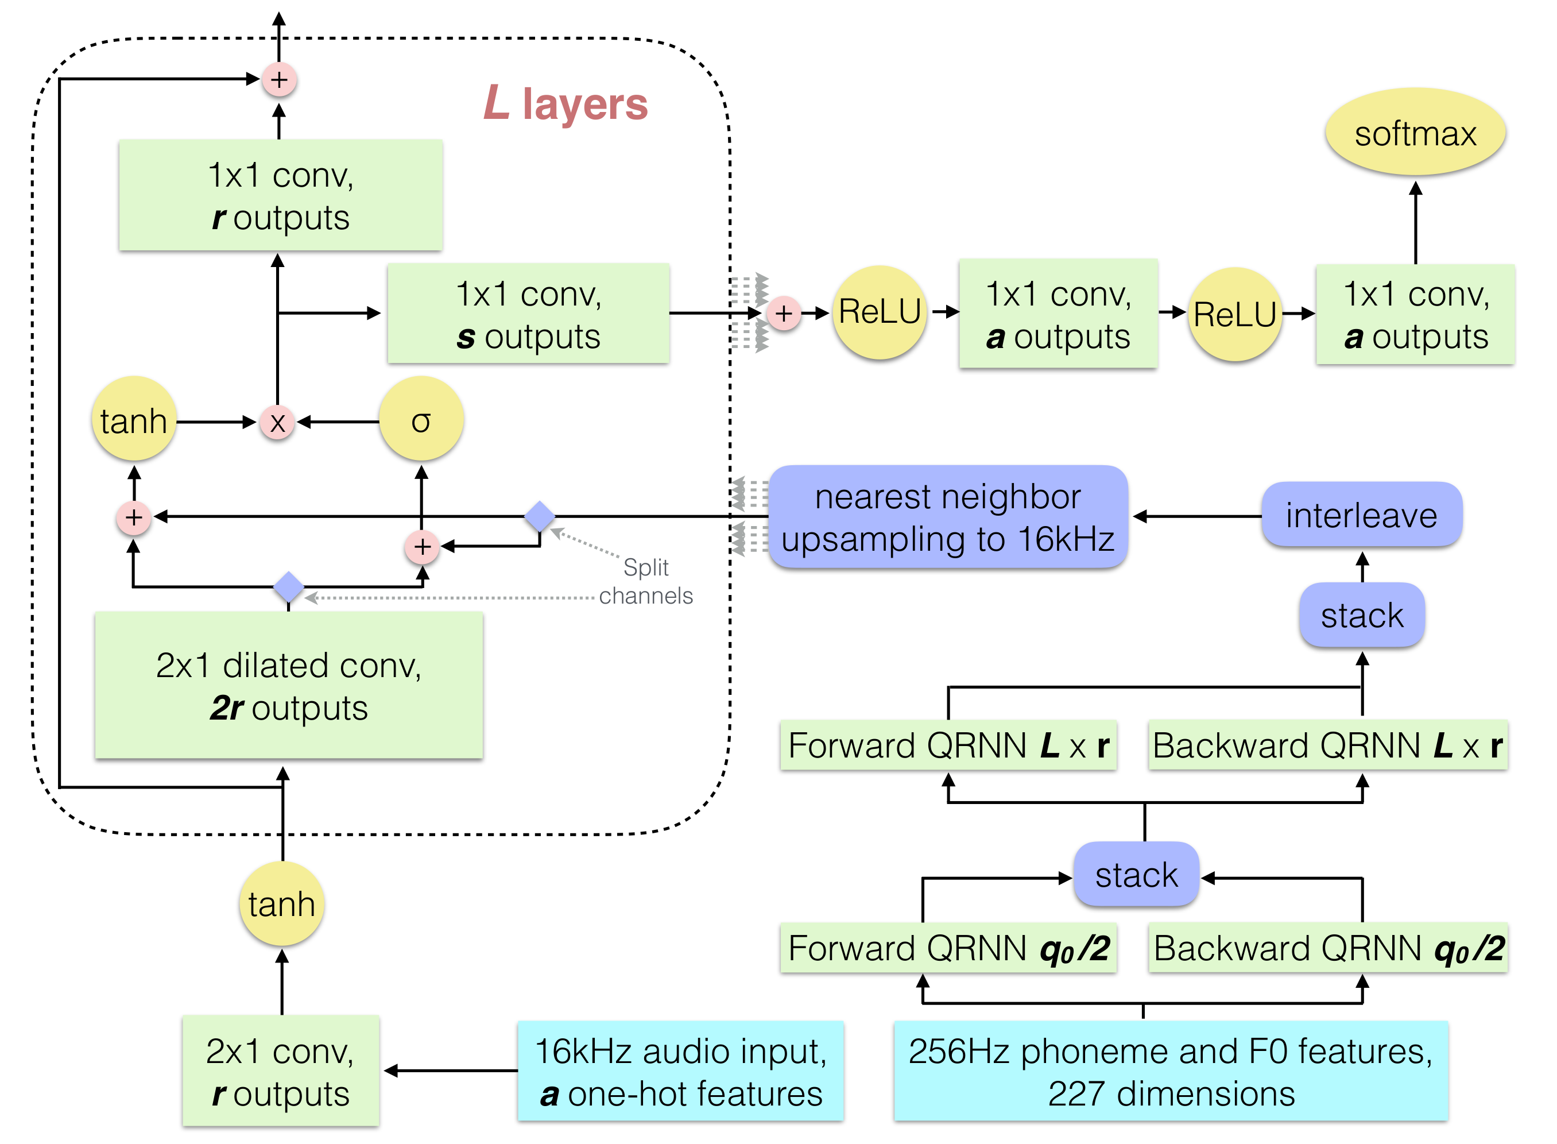
Appendix A
The modified WaveNet architecture
Components are colored according to function: teal inputs, green convolutions and QRNNs, yellow unary operations and softmax, pink binary operations, and indigo reshapes, transposes, and slices.

